Slide 1
23HUT455 ORGANIZATIONAL BEHAVIOUR

Slide 2
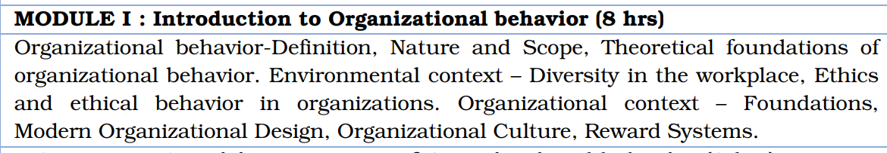
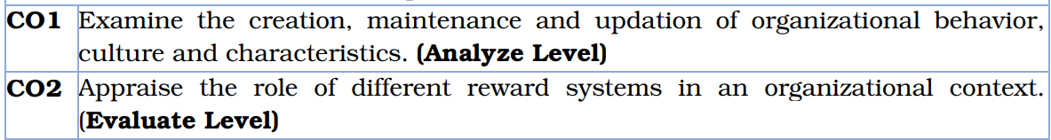
SYLLABUS AND COURSE OUTCOME

Slide 3
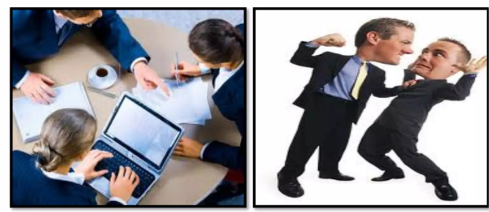
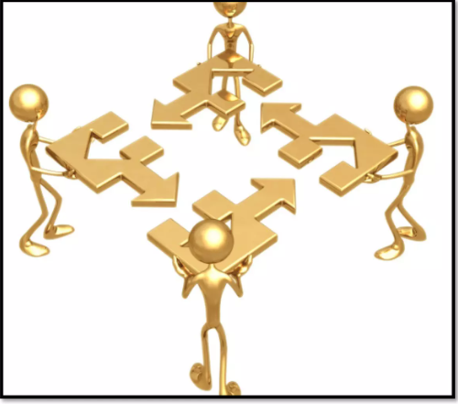
What is an Organization?
Regarded as group of individuals contributing their efforts towards common goal
What is an Organizational Behaviour?
Understanding, prediction, and management of human behavior in organizations

Slide 4
Activity 1: Team Selection and Self-Reflection Aim: To help students understand the importance of behavior, skills, and attributes in team selection processes, emphasizing relevance in professional and organizational settings.
Activity Description: Randomly select 10 students to act as team leaders/managers of a hypothetical company project. Each leader selects 7-8 students from the rest of the class to form their project team. Some students may be picked for multiple teams, while others might not be selected at all. Leaders write the names of their team members on the board. All students reflect on: Why they were selected. Why they might not have been selected (for those not chosen by any leader).
Reflection Questions: What qualities do you think led to your selection (or non-selection)? What changes can you make in your behavior to enhance your chances of being chosen in similar situations?

Slide 5
Reflection on Activity conducted on 16-12-2024
Selected Criteria
Hardworking and Dedication
Teamwork skills
Planning and Time Management
Communication
Responsibility
Technical Skills/Critical thinking
Truthfulness and Patience
Documentation
Friendship
Why Not selected?
Friendship → Biasing
Corruption
Unrecognized talent
Lack of confidence → Stage fear
Lack of Communication skills

Slide 6
Nature of OB
Multidisciplinary: Organizational Behavior draws insights from various
disciplines such
Psychology
Sociology
Anthropology
Management
2. Systematic Study: Researchers use empirical evidence and data to analyze and
understand patterns of behavior within organizations
3. Applied Science: Apply theories and concepts to enhance organizational
effectiveness and improve the quality of work life
4. Contingency Approach: No one-size-fits-all solution to organizational challenges.
Effectiveness of organizational practices depends on the
specific situation, context, and environment

Slide 7
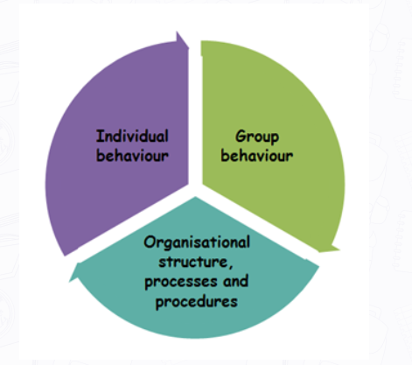
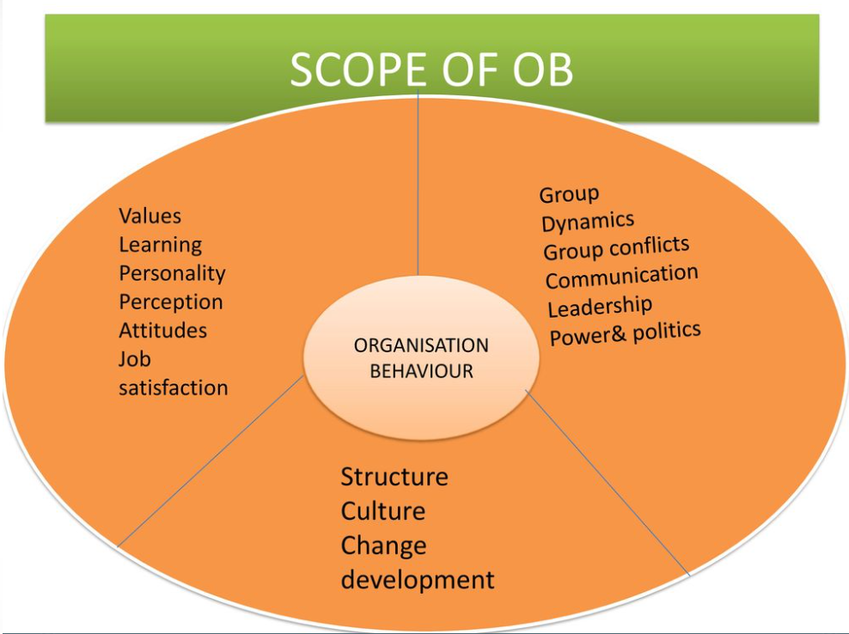
Scope of OB
Comprehensive, addressing a wide range of factors that influence how people behave within organizations
By understanding these elements, organizations can create better work environments, improve employee satisfaction and performance, and achieve organizational goals more effectively.

Slide 8
Scope of OB
Individual Behavior
Personality: Examines how individual traits and characteristics influence behavior at work.
Attitudes and Job Satisfaction: Studies how employee attitudes (e.g., job satisfaction, organizational commitment) affect performance and retention.
Perception: Looks at how individuals interpret their environment and the impact this has on their work behavior.
Learning and Development: Focuses on how employees acquire skills and knowledge and the effect of training and development on performance.
Motivation: Analyzes what drives individuals to work towards goals and how motivational theories can be applied to enhance performance.

Slide 9
Scope of OB
Group Behavior
Group Dynamics: Investigates how people behave in groups, including the formation of groups, group cohesion, roles, and norms.
Teamwork: Studies how teams are formed, how they function, and how team performance can be improved.
Communication: Explores the processes of communication within groups and the barriers to effective communication.
Leadership: Examines different leadership styles and their impact on group behavior and performance.
Power and Politics: Looks at how power dynamics and political behavior influence decision-making and relationships within groups.
Conflict and Negotiation: Studies the sources of conflict within groups and strategies for conflict resolution and negotiation.

Slide 10
Scope of OB
Organizational Structure
Organizational Design: Investigates different types of organizational structures (e.g., hierarchical, flat, matrix) and their impact on behavior
Work Processes: Examines how tasks and workflows are organized and their impact on efficiency and effectiveness
Roles and Responsibilities: Defines how roles and responsibilities are distributed within the organization and their effect on behavior and performance
Organizational Culture
Values and Beliefs: Studies the core values and beliefs that shape organizational culture and behavior
Norms and Practices: Looks at the unwritten rules and standard practices that influence how work is done
Cultural Change: Explores how organizational culture evolves over time and how it can be managed or changed

Slide 11
Scope of OB
Change Management
Change Processes: Studies the processes and stages of organizational change and how to manage them effectively
Resistance to Change: Looks at why employees resist change and strategies to overcome resistance
Innovation: Examines how organizations can foster innovation and creativity among employees

Slide 12
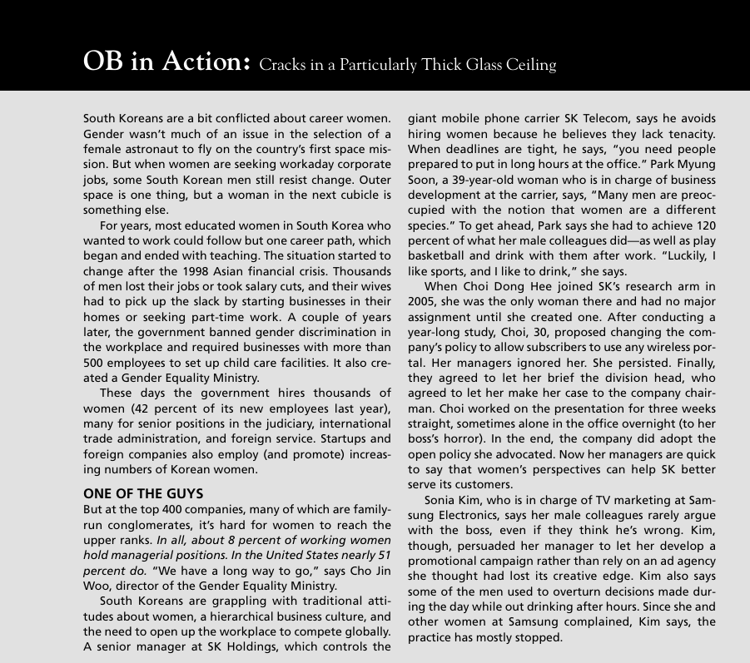
Diversity in Workplace

Slide 13
What comes to mind when you hear the word
DIVERSITY?
India has experienced a notable 33% year-on-year increase in diversity hiring, reflecting a heightened emphasis on diversity and inclusion (D&I) policies among companies.
Read more at:
https://economictimes.indiatimes.com/jobs/hr-policies-trends/india-sees-33-annual-surge-in-diversity-hiring-driven-by-bfsi-and-it-sectors/articleshow/111594298.cms?utm_source=contentofinterest&utm_medium=text&utm_campaign=cppst
Notes:
We hear much about diversity. In fact, if you were to conduct a survey of 20 people and ask them to define diversity, you would most likely receive 20 different definitions.
Take a moment and think about this:
What comes to your mind when you hear the word DIVERSITY?

Slide 14
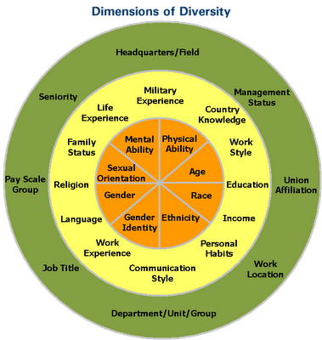
Diversity means much more than ethnicity, gender, or sexual orientation
New and evolving diverse populations include a full range of ages, as well as career and geographic experiences
Organizational diversity initiatives should not simply focus
On getting people of color and women in the door,
But embracing an inclusive culture to maintain these employees

Slide 15
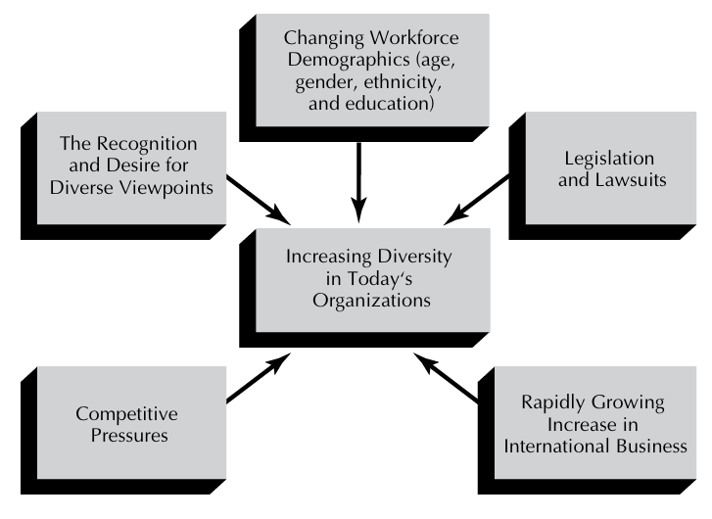
Reasons for the Emergence of Diversity
Changing demographics
Older workers, women, minorities, and those with more education are now entering the workforce
Composition of today’s and tomorrow’s workforce is and will be much different from that of the past

Slide 16
Legislation and Lawsuits in India
Constitution of India: Articles 14, 15, 16, and 39 of the Constitution of India protect diversity and prohibit discrimination
Rights of Persons with Disabilities Act, 2016: Cornerstone of disability diversity law
Equality Act 2006: Equal pay for men and women for the same or similar work
The Sexual Harassment of Women at Workplace Act, 2013: Mechanism for women to report incidents of sexual harassment at their workplace
Transgender Persons (Protection of Rights) Act, 2019: Rights of transgender people
Equal Remuneration Act, 1976: Provide equal pay for men and women who perform the same work, without any discrimination during the recruitment process
Non-Discrimination Against Women: The Maharashtra Shops and Establishments Act, 2017
Successful law suits with resulting multimillion dollar penalties have in recent years been brought against many well-known firms

Slide 17
Competitive pressures
Firms that aggressively try to hire and promote women and minorities are going to end up with more talented and capable workforce
Companies that gain a reputation for “celebrating diversity” are more likely to attract the best employees
Racial diversity interacted with business strategy increases
Productivity
Return on equity
Market performance
Diversity not only adds value contributes to a firm’s competitive advantage

Slide 18
Recognize and obtain diverse viewpoints
Diversity leads to innovation and often breakthrough competitive advantages
Women working for Reebok pointed out that there was no good shoe available for aerobics.
Breakthrough for Reebok in the very competitive athletic shoe industry.
Chemical firm DuPont, which used input from African American employees to develop and successfully market agricultural products for small farmers in the South

Slide 19
Rapidly growing International Business
More and more organizations are entering the international arena
If domestic organizations have and promote diversity, then, as they expand globally, they will be accustomed to working with people who have different cultures, customs, social norms, and mores

Slide 20
Developing the Multicultural Organization
A multicultural organization has been described as one that
Reflects the contributions and interests of diverse cultural and social groups in its mission, operations, and product or service
Acts on a commitment to eradicate social oppression in all forms within the organization
Includes the members of diverse cultural and social groups as full participants, especially in decisions that shape the organization
Follows through on broader external social responsibilities, including support of other institutional efforts to eliminate all forms of social oppression

Slide 21
As the Microsoft Diversity Director declared:
We need to stress that all human cultures have common needs, a common sense of humanity. But there are differences, too. How in the world do you please a customer, for example, if you don’t know what he or she values? That’s what culture is all about, that’s what differences are all about. Diversity assumes not only that people are different—we know that—but that their difference is value-added. If you know how to harness that difference, you’ll be more competitive as a corporation than those firms that don’t, whether in the domestic marketplace, and certainly in the global marketplace

Slide 22
Individual Approaches to Managing Diversity
1. Learning
Many managers are often unprepared to deal with diversity
Those who may not think they need to learn about diversity must work especially hard to learn and experience
Strategies
Communication
Develop a personal style that works well with each member
Encourage diverse employees to give them candid feedback
Discussion/Brainstorming Question
If you are a manager who are unprepared, what strategies are going to adopt for managing the diversity?

Slide 23
Individual Approaches to Managing Diversity
2. Empathy
Ability to put oneself in another’s place and see things from that person’s point of view
Helps the manager understand the diverse employee’s point of view

Slide 24
Organizational Approaches to Managing Diversity
Testing
Use of tests for selection and evaluation is that they may be culturally biased
Culturally biased tests
Skill based Test
Carefully conducted interviews or role playing

Slide 25
Organizational Approaches to Managing Diversity
2. Training
Diversity training
Firms that adopted diversity training tended to have the following profile:
Large size
Positive top-management beliefs about diversity
High strategic priority of diversity relative to other competing objectives
Presence of a diversity manager
Existence of a large number of other diversity supportive policies
Two ways in which this training can play a key role
Offering training to diverse groups
Provide training to managers and other employees who work with diverse employees

Slide 26
Organizational Approaches to Managing Diversity
Major problem: Transfer problem
Those going through the diversity training may see the value and gain some relevant knowledge, but then do not transfer this training back to the job
3. Mentoring
A mentor is a trusted counselor, coach, or advisor who provides advice and assistance
Assigning mentors to women and minorities

Slide 27
Organizational Approaches to Managing Diversity
Mentor program: Support members of a diverse group
Their jobs
Socialize them in the cultural values of the organization
Pragmatically help them chances for development and advancement
Benefits that mentors can provide to those they assist
Identify the skills, interests, and aspirations the person has
Provide instruction in specific skills and knowledge critical to successful job performance
Help in understanding the unwritten rules of the organization and how to avoid saying or doing the wrong things
Answer questions and provide important insights
Offer emotional support
Serve as a role model
Create an environment in which mistakes can be made without losing self-confidence

Slide 28
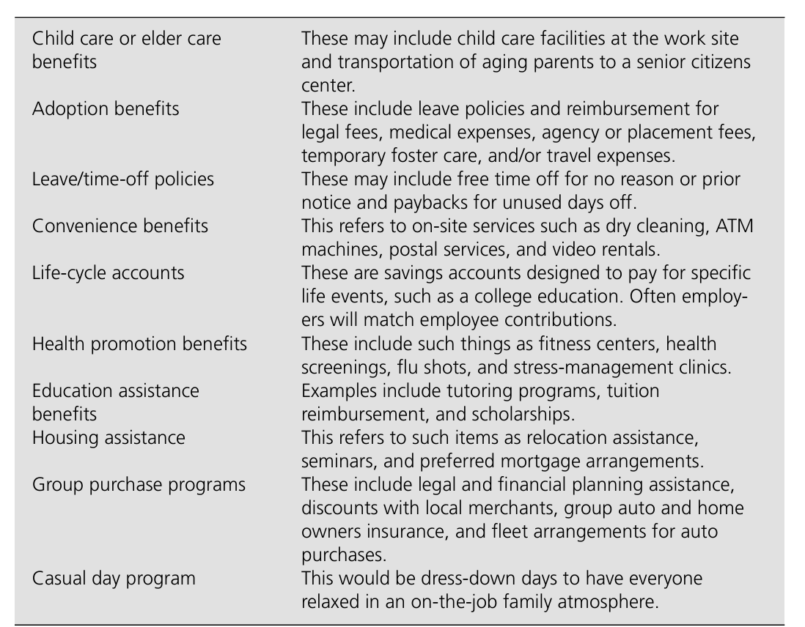
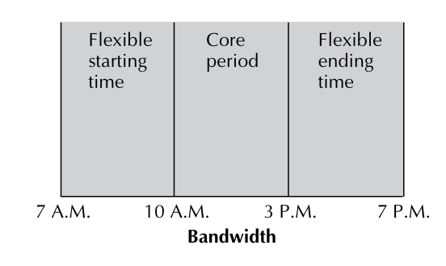
Organizational Approaches to Managing Diversity
4. Work/Family Programs
Flextime
Compressed workweek
Job sharing
Telecommuting
Innovative family-friendly programs

Slide 29
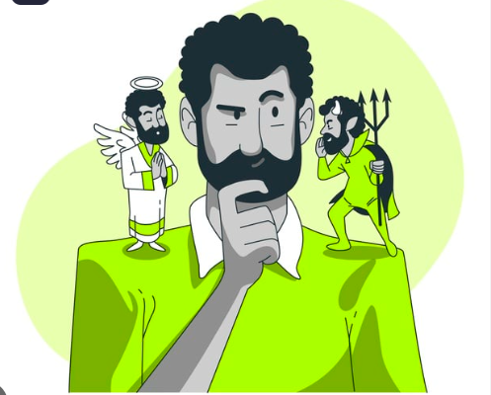
ETHICS AND ETHICAL BEHAVIOR IN ORGANIZATIONS

Slide 30
Ethics
Ethics involves moral issues and choices and deals with right and wrong behavior
Ethical behavior is determined by
Cultural: Family, friends, neighbors, education, religion, and the media
Organizational: Ethical codes, role models, policies and practices, and reward and punishment systems
External environment: Political, legal, economic, and international developments.

Slide 31
Ethics
Peer pressure on many people to be less ethical
One person or group finds unethical may be viewed differently by another individual or group

Slide 32
Self Reflection Activity
Ethical issues are very much at the forefront of organizational behavior in today’s environment. One controversial issue concerns monitoring employees. Technology has now made it easy and inexpensive for employers to closely monitor the behaviors of employees. Do you believe employers should be allowed to electronically monitor workers? Would you like to be monitored in this fashion? Justify.

Slide 33
Organizational Structure
Defines how job tasks are formally divided, grouped and coordinated
Organizational Design: Six Key elements
Key Question | Answer provided by
To what degree are tasks subdivided into separate jobs? | Work specialization
On what basis will jobs be grouped together? | Departmentalization
To whom do individuals and groups report? | Chain of Command
How many individuals can a manager efficiently and effectively direct? | Span of Control
Where does decision making authority lie? | Centralization and Decentralization
To what degree will there be rules and regulations to direct employees and managers? | Formalization

Slide 34
Organizational Structure – Work Specialization
Degree to which tasks in an organization are subdivided into separate jobs
Entire job is not done by one individual but instead is broken down into steps, and each step is completed by a different person
Individual employees specialize in doing part of an activity rather than the entire activity.
Initially, employee productivity rose initially
When used to extreme, human diseconomies from work specialization
Boredom
Fatigue
Stress
Poor quality
Increased absenteeism

Slide 35
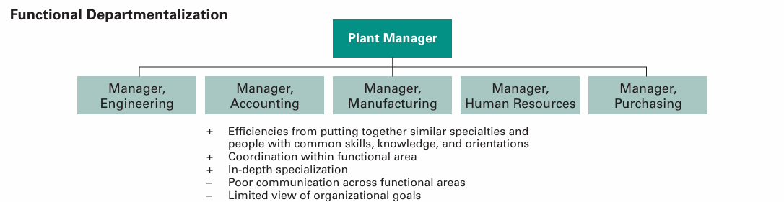
Organizational Structure – Departmentalization
Once jobs have been divided up through work specialization, they have to be grouped back together so that common tasks can be coordinated
Basis on which jobs are grouped together

Slide 36
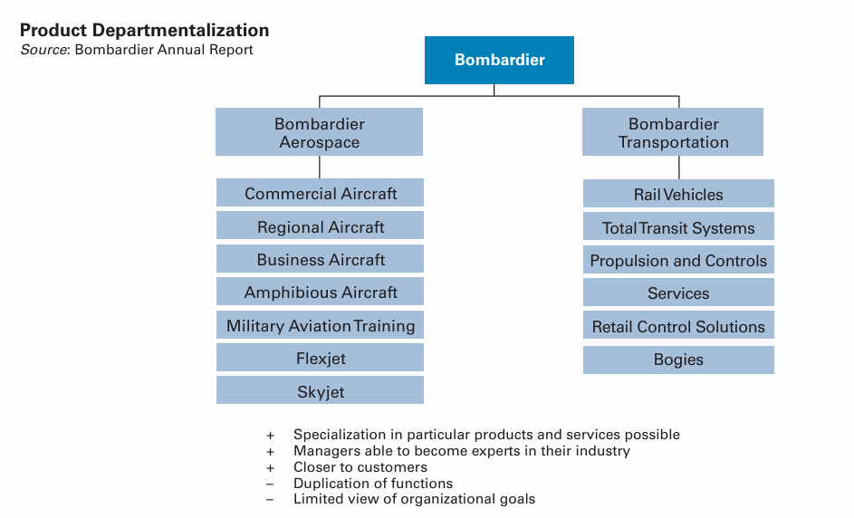
Organizational Structure – Departmentalization

Slide 37
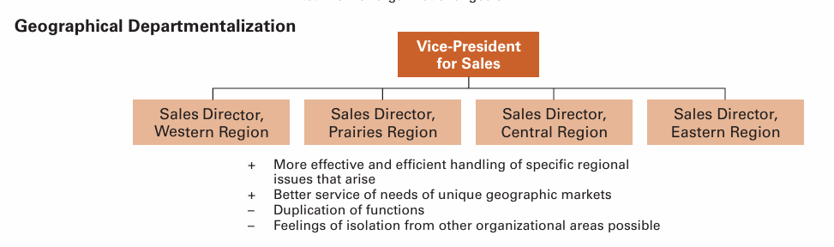
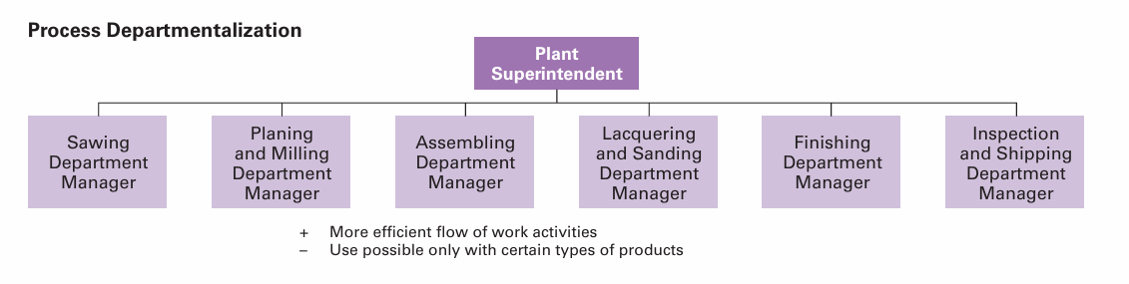
Organizational Structure – Departmentalization

Slide 38
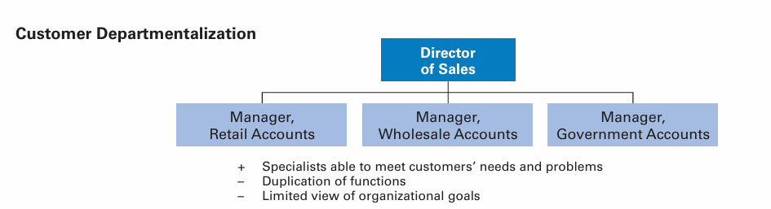
Organizational Structure – Departmentalization

Slide 39
Organizational Structure – Chain of Command
Clarifies who reports to whom
Helps employees answer questions such as “Who do I go to if I have a problem?” or “To whom am I responsible?”
Authority: Rights inherent in a managerial position to tell people what to do and to expect them to do it
Responsibility: Obligation or expectation to perform
Accountability: Need to report and justify work to the superiors
Unity of command: Every employee should receive orders from only one superior
Delegation: Assignment of authority to another person to carry out specific duties

Slide 40
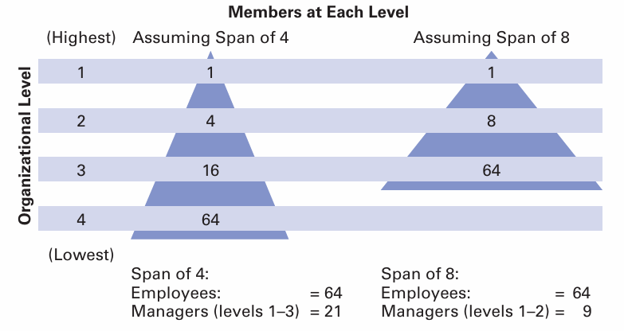
Organizational Structure – Span of Control
How many employees can a manager efficiently and effectively manage?
Determines the number of levels and managers an organization needs

Slide 41
Organizational Structure – Centralization and Decentralization
Centralization: Degree to which decision making is concentrated at a single point in the organization
Decentralization: The more that lower-level employees provide input or actually make decisions
An organization is never completely centralized or decentralized
Increased decentralization is employee empowerment
Companies facing dynamic environments: Decentralized
Stable environments: Centralized

Slide 42
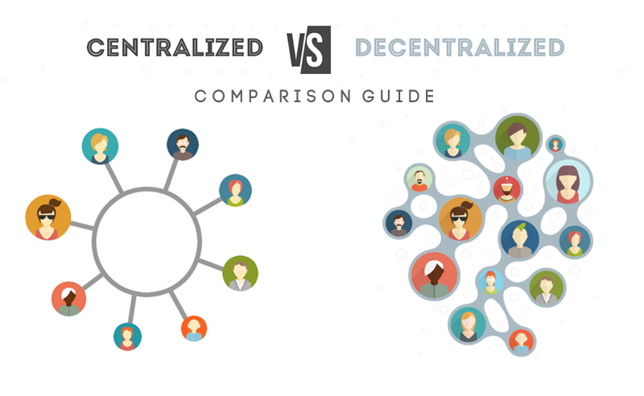

Slide 43
Organizational Structure – Formalization
Degree to which jobs within the organization are standardized
Extent to which employee behaviour is guided by rules and procedures
Highly formalized → Person doing that job has little freedom to choose
what is to be done
when it is to be done
how he or she does it

Slide 44
Organizational Structure – Formalization
Organizations with high formalization
Explicit job descriptions
Numerous organizational rules
Clearly defined procedures covering work processes
Low formalization
Job behaviours are relatively unstructured
Employees have a great deal of freedom in how they do their work

Slide 45
Traditional Organizational Structure
SIMPLE STRUCTURE
Low departmentalization
Wide spans of control
Authority centralized in a single person
Little formalization
Small businesses in which the owner and manager are one and the same
When organization grows, it reaches a point where it has to add employees
As the number of employees rises, the structure tends to become more specialized and formalized.
Rules and regulations are introduced, work becomes specialized, departments are created, levels of management are added, and the organization becomes increasingly bureaucratic

Slide 46
Traditional Organizational Structure
FUNCTIONAL STRUCTURE
Groups similar or related occupational specialties together
Functional approach to departmentalization applied to the entire organization
DIVISIONAL STRUCTURE
Consists of separate business units or divisions
Each unit or division has relatively limited autonomy

Slide 47
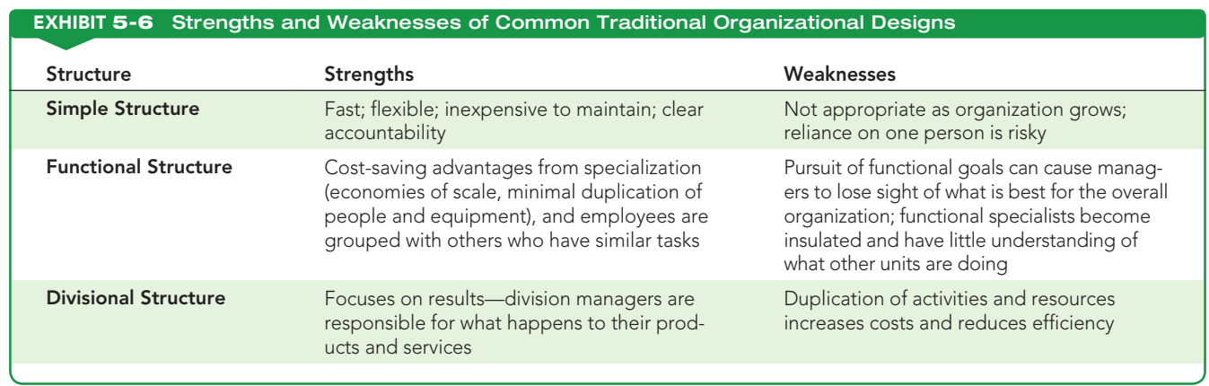
Traditional Organizational Structure

Slide 48
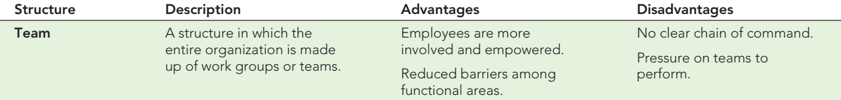
Contemporary Organizational Structure
TEAM STRUCTURE
Most big projects in small, tightly focused teams
Entire organization is made up of work groups or teams that perform the organization’s work
Employee empowerment is crucial
Employee teams are free to design work in the way they think is best
Teams are held responsible for all work and performance results in their respective areas

Slide 49
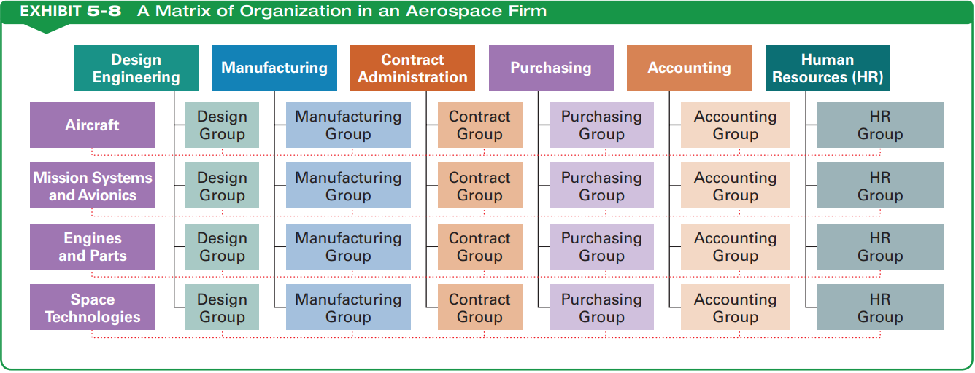
Contemporary Organizational Structure
MATRIX STRUCTURE
Assigns specialists from different functional departments to work on one or more projects led by project managers
Once a project is completed, the specialists return to their functional departments
Dual chain of command
Two managers: Functional department manager & product managers
Communicate regularly
Coordinate work demands on employees
Resolve conflicts together

Slide 50
Contemporary Organizational Structure
PROJECT STRUCTURE
Employees continuously work on projects
No formal departments that employees return to at the completion of a project
Employees take their specific skills, abilities, and experiences to other projects
No departmentalization or rigid organizational hierarchy
Managers act as facilitators, mentors, and coaches.

Slide 51
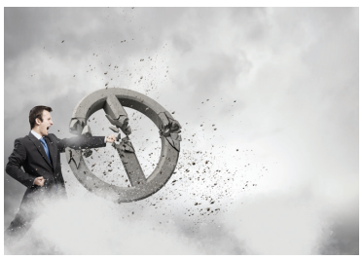
Contemporary Organizational Structure
BOUNDARYLESS ORGANIZATION
No predefined structure
Eliminate the chain of command
Places no limits on spans of control
Replaces departments with empowered teams

Slide 52
Contemporary Organizational Structure
VIRTUAL ORGANIZATIONS
Elements of a traditional organization
Relies on recent developments in information technology to get work done.
Organization could consist of a small core of full-time employees
Plus outside specialists hired on a temporary basis to work on the need of the hour opportunities
Composed of employees who work from their own home offices

Slide 53
Contemporary Organizational Structure
NETWORK ORGANIZATIONS
small core organization that outsources major business functions.
Allows organizations to concentrate on what they do best
Contract out other activities to companies that specialize in those activities
Managers should be aware of some of the problems involved in outsourcing, • Choosing the wrong activities to outsource
Choosing the wrong vendor
Writing a poor contract
Failing to consider personnel issues
Losing control over the activity
Ignoring the hidden costs

Slide 54
Organizational Culture
When people join an organization, they bring with them the values and beliefs they have been taught
Values and beliefs are insufficient for helping the individual succeed in the organization

Slide 55
Organizational Culture - Characteristics
1. Observed behavioral regularities: When organizational participants interact with one another, they use common language, terminology, and rituals related to deference and demeanor
2. Norms: Standards of behavior exist, including guidelines on how much work to do
“Do not do too much; do not do too little.”
3. Dominant values: High product quality, low absenteeism, and high efficiency
4. Philosophy: Policies that set forth the organization’s beliefs
5. Rules: Strict guidelines related to getting along in the organization
6. Organizational climate: Overall “feeling” that is conveyed by the physical layout, the way participants interact, and the way members of the organization conduct themselves with customers or other outsiders

Slide 56
Dominant Culture Vs Subculture
Dominant culture: Set of core values shared by a majority of the organization’s members
Hard work
Company loyalty
Need for customer service
Subculture: Set of values shared by a minority, usually a small minority, of the organization’s members
Subcultures can weaken and undermine an organization if they are in conflict with the
dominant culture and/or the overall objectives
Ford makes cars, Sony makes TVs, Microsoft makes software, what does Disney make?
Disney makes people happy!

Slide 57
CREATING AND MAINTAINING A CULTURE
1. A single person (founder) has an idea for a new enterprise.
2. The founder brings in one or more other key people and creates a core group that shares
3. The founding core group begins to act in concert to create an organization by raising funds, obtaining patents, incorporating, locating space, building.
4. At this point, others are brought into the organization, and a common history begins to be built

Slide 58
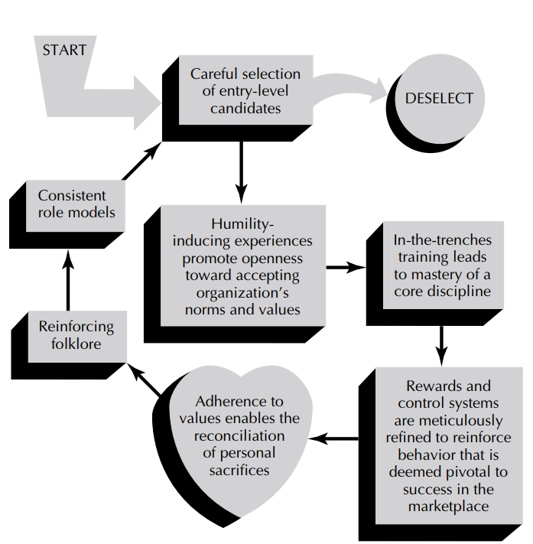
Maintaining Cultures through Steps of Socialization

Slide 59
Activity on Organizational Culture:
Analyze the culture of your institution and identify its strengths and areas for improvement. How does the existing culture impact student collaboration, faculty-student interactions, and overall academic performance? Suggest actionable strategies to enhance the institutional culture for better inclusivity and innovation.

Slide 60
REWARD SYSTEMS
Discussion Topic
What comes under your mind when you heard of “ Reward system” in an organization?
PAY: THE DOMINANT ORGANIZATIONAL REWARD
1. Base Pay approach
2. Merit Pay approach
3. Individual Incentive Pay Plans
4. Use of Bonuses
5. Use of Stock Options
6. Group Incentive Pay Plans

Slide 61
REWARD SYSTEMS
RECOGNITION AS AN ORGANIZATIONAL REWARD
1. When introducing new recognition procedures and programs, let everyone know what is going on
2. Educate the managers so that they use recognition as part of the total compensation package
3. Make recognition part of the performance management process, so that everyone begins to use it
4. Have site-specific recognition ceremonies that are featured in the company’s communication outlets
5. Publicize the best practices of employees, so that everyone knows some of the things to earn recognition
6. Let everyone know the steps that the best managers are taking to use recognition effectively
7. Continually review the recognition process in order to introduce new procedures and programs and scrap those that are not working well.
8. Solicit recognition ideas from both employees and managers, as they are the ones who are most likely to know what works well—and what does not

Slide 62
REWARD SYSTEMS
BENEFITS AS ORGANIZATIONAL REWARD
Federal Government–Mandated Benefits: Social Security
Life, Disability, and Health Insurance
Private Pension Benefits
Time-Off Benefits : Paid time offs such as Vacations/regional holidays/Sick leave
Wellness Programs
Life Cycle Benefits : Child care and elder care

Slide 63
THANK YOU

